Slide 1


INDIAN SPACE RESEARCH ORGANIZATION
PROJECT PRESENTATION ON
ANOMALY DETECTION FOR NGC APPLICATIONS
SUBMITTED BY:
DEEPAK P
VAISHNAVI BS
UNDER THE GUIDANCE OF:
Mrs. PRIYANKA V
Mr. PRASAD G
SUBMITTED TO:
Dr. RAVI KUMAR
GROUP DIRECTOR
OILS DIVISION
ISRO, BANGALORE - 560075

Slide 2
Introduction

Slide 3
What is Anomaly detection
This presentation offers a comprehensive insight into anomaly detection, an indispensable tool in data analysis. From delineating anomalies to delineating the methodology, we navigate the intricacies of identifying and comprehending outliers in datasets.

Slide 4
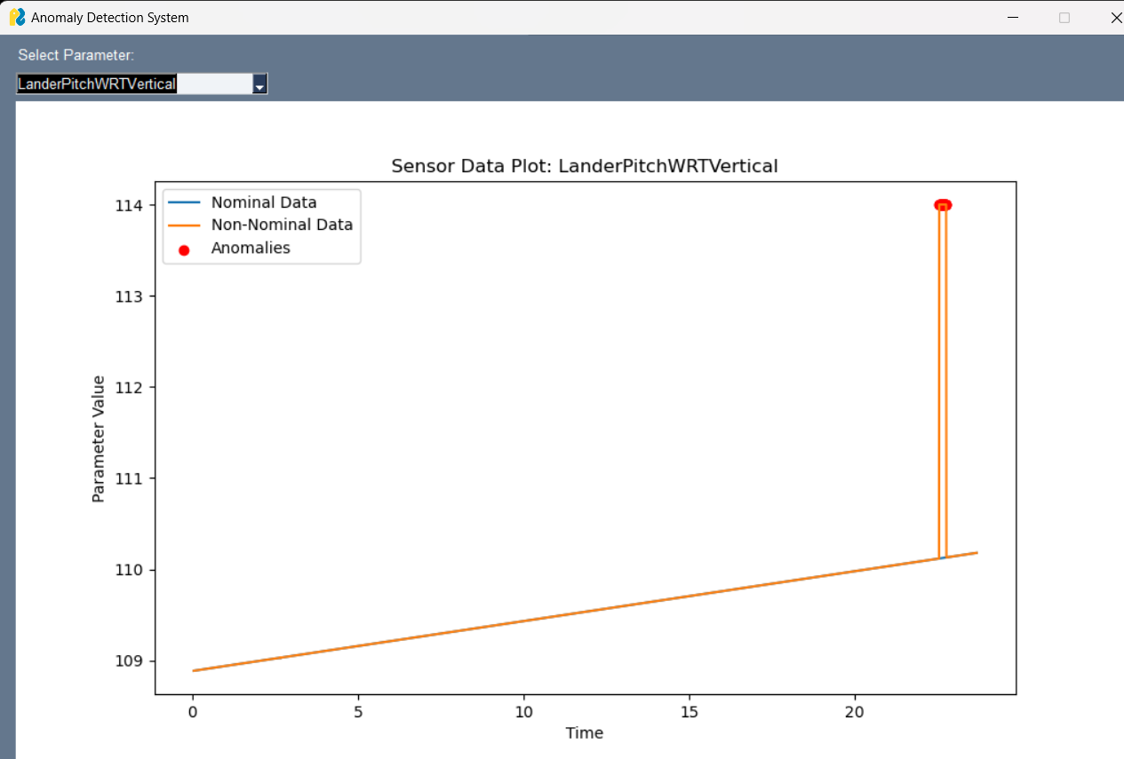
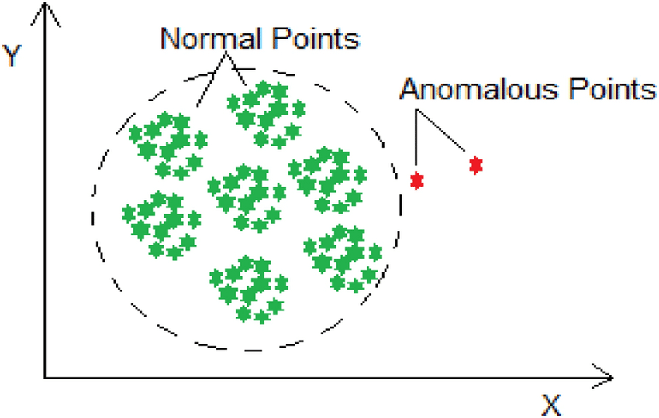
Point anomaly
Point anomalies are singular data instances significantly deviating from the dataset norm, often indicating errors or rare events. Detection relies on statistical methods like z-score and machine learning algorithms such as Isolation Forest. Example: A sudden, abnormal temperature spike in sensor data.

Slide 5
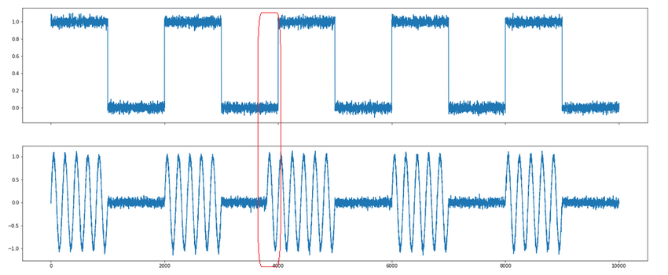
Contextual anomaly
Contextual anomalies occur when a data instance is anomalous only in a specific context or subset of the data. Unlike point anomalies, these deviations are not apparent when examining the entire dataset but become evident when considering contextual information. Detection of contextual anomalies requires understanding the relationships and dependencies within the data and identifying deviations from expected contextual patterns.

Slide 6
Methodology
Data collection
Preprocessing
Feature engineering
Model selection
Model training
Evaluation
Deployment

Slide 7
Data extraction
1. Identify Data Sources:
- Determine sources such as databases, sensors, logs, or external APIs containing relevant information.
2. Data Retrieval:
- Extract data from the identified sources while ensuring data integrity and security protocols.
3. Data Integration:
- Combine data from multiple sources into a unified dataset, resolving any inconsistencies or discrepancies.
4. Data Transformation:
- Convert the raw data into a structured format suitable for analysis, ensuring compatibility with subsequent processing steps.
5. Data Quality Check:
- Perform preliminary checks to identify and address data quality issues such as missing values, duplicates, or outliers.

Slide 8
Data cleaning
Data cleaning is a critical preprocessing step aimed at ensuring the quality and reliability of the dataset for subsequent analysis. It involves handling missing values by employing techniques such as imputation or deletion without compromising data integrity.
Additionally, removing duplicate records eliminates redundancy, maintaining dataset consistency. Outliers, which can distort analysis results, are detected and treated using statistical methods or domain knowledge. Normalizing or standardizing numerical features ensures uniformity in scale, preventing bias in model training.
Categorical variables are encoded into numerical representations for compatibility with machine learning algorithms. Quality assurance measures are implemented to guarantee data cleanliness, consistency, and suitability for further analysis, laying the foundation for robust anomaly detection.
import pandas as pd
data = pd.read_csv("your_dataset.csv")
data.dropna(inplace=True)
data.drop_duplicates(inplace=True)
# Save cleaned data to a new file or overwrite the original file
data.to_csv("cleaned_dataset.csv", index=False)

Slide 9
Preprocessing data
Feature Scaling
Dimensionality Reduction
Handling imbalanced data
Text data processing
Feature engineering
# Handling Imbalanced Data
X_resampled, y_resampled = SMOTE().fit_resample(data.drop('target_column', axis=1)
# Text Data Processing
text_data_tfidf = TfidfVectorizer().fit_transform(data['text_column'])
data = pd.read_csv("your_dataset.csv")
scale_data = StandardScaler().fit_transform(data)
reduced_data = PCA(n_components=2).fit_transform(scale_data)

Slide 10
Exploratory data analysis
EDA is a crucial phase in data analysis aimed at gaining insights and understanding the dataset's characteristics. It involves:
1. Descriptive Statistics: Summarizing the dataset's central tendency and dispersion using measures like mean, median, and standard deviation.
2. Data Visualization: Utilizing graphical representations such as histograms, box plots, and scatter plots to visualize data distribution, relationships, and patterns.
3. Correlation Analysis: Exploring correlations between variables to identify associations and dependencies.
4. Outlier Detection: Identifying and understanding outliers to assess their impact on the dataset.
5. Feature Importance: Determining the significance of features to guide feature selection or engineering efforts.
6. Hypothesis Testing: Formulating and testing hypotheses using statistical tests to validate assumptions or uncover insights.
7. Interactive Exploration: Using interactive visualization tools to facilitate dynamic exploration and analysis, enabling deeper insights and discoveries.

Slide 11
Model building
Isolation Forest: A tree-based algorithm that isolates anomalies by randomly partitioning the dataset into subsets. Anomalies are identified as instances that require fewer partitions to isolate.
k-Nearest Neighbors (kNN): An instance-based algorithm that identifies anomalies based on their distance to the k nearest neighbors in the feature space. Instances with few neighbors are considered anomalies.
One-Class Support Vector Machines (One-Class SVM): A support vector machine-based algorithm that learns the boundary of normal instances in the feature space and classifies instances outside this boundary as anomalies.
Autoencoders: Deep learning models that learn to reconstruct input data and identify anomalies based on reconstruction error. Instances with high reconstruction error are considered anomalies.
Local Outlier Factor (LOF): A density-based algorithm that computes the local density of instances and identifies outliers as instances with substantially lower density compared to their neighbors.

Slide 12
Fitting the data to the Selected Model
from sklearn.ensemble import IsolationForest
# Model Initialization
model = IsolationForest(n_estimators=100, contamination=0.1, random_state=42)
# Training
model.fit(preprocessed_data)
1. Model Initialization
2. Training
3. Hyperparameter Tuning
4. Model Validation
5. Monitoring
6. Iterative Improvement

Slide 13
Algorithms used
1. Isolation Forest:
Isolation Forest is an ensemble-based anomaly detection algorithm that isolates anomalies by randomly partitioning the dataset into subsets using decision trees.
Anomalies are identified as instances that require fewer partitions to isolate, making them stand out as 'isolated' observations.
It is efficient for high-dimensional datasets and can handle large datasets with minimal hyperparameter tuning.
2. k-Nearest Neighbors (kNN):
k-Nearest Neighbors is an instance-based algorithm that identifies anomalies based on the distance of each instance to its k nearest neighbors in the feature space.
Anomalies are typically instances with few neighbors, indicating they are dissimilar to the majority of the data points.
kNN is simple and easy to understand, making it a popular choice for anomaly detection tasks. However, it may suffer from computational inefficiency in high-dimensional spaces.

Slide 14
Parameter dependency
Data dependency refers to the relationship between different datasets or data sources where one dataset relies on another for its validity, accuracy, or interpretation. In the context of anomaly detection, data dependency often involves two main types of datasets:
Nominal Data:
Nominal data serves as a reference or baseline for normal behavior patterns.
It typically includes historical data or predefined thresholds representing expected values for various parameters.
Nominal data is used as a comparison point to identify deviations and anomalies in real-time or incoming data.
Non-Nominal Data:
Non-nominal data consists of observations collected during system operation, which may include anomalies or deviations from expected behavior.
This data is used for anomaly detection, where algorithms compare incoming data against the nominal reference to identify anomalies or abnormal patterns.
Parameter-Dependency Data example :
'mass-dynamics':['Engine1-Thrust','Engine2-Thrust','Engine3-Thrust','Engine4-Thrust','CentalEngine-Thrust - NA]
'LanderHeightFromSurface (With DEM)':['Engine1-Thrust','Engine2-Thrust','Engine3-Thrust','Engine4-Thrust','LanderYawWRTVertical','LanderRollWRTVertical','LanderPitchWRTVertical']

Slide 15
Fishbone structure for Root cause
Parameter 3
LanderHeightFromSurface (With DEM)
Parameter 2
Engine1-Thrust
Parameter 1
Mass Dynamics
Train
Train
Train
ANOMALY DETECTED
Test
Test
Test
Train
Train
Train
Parameter 4
LanderRollWRTVertical
Parameter 5
CdA-Ox-1
Parameter 6
Oxidizer Consumed

Slide 16
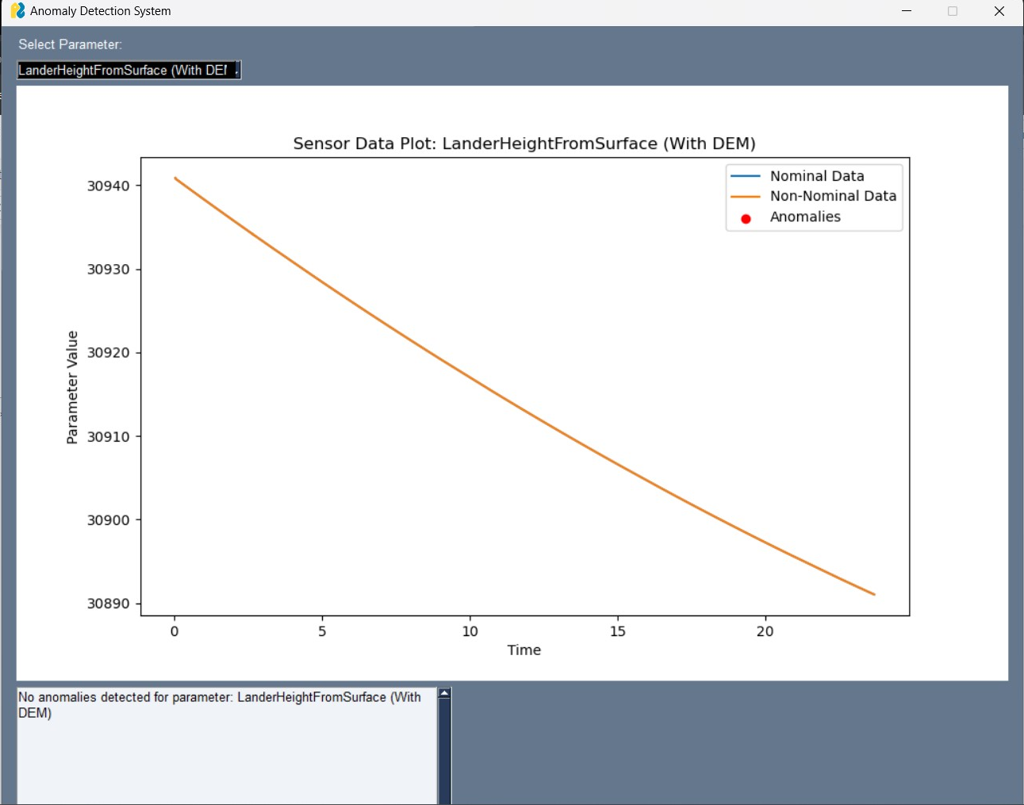
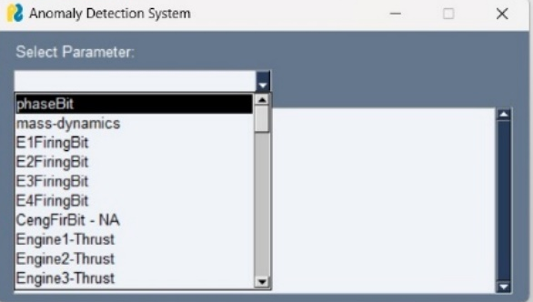
Output Snippets

Slide 17
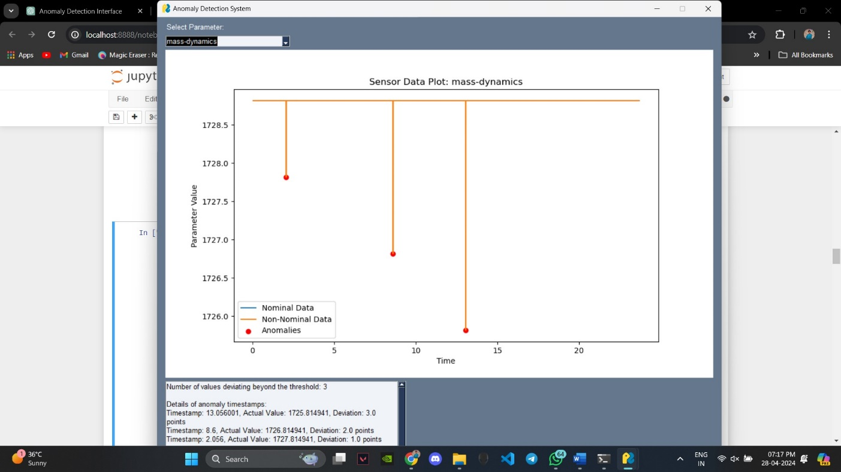
Plot for a selected parameter
1. mass-dynamics
Anomalies detected are identified and are updated in an interval of 5ms.

Slide 18
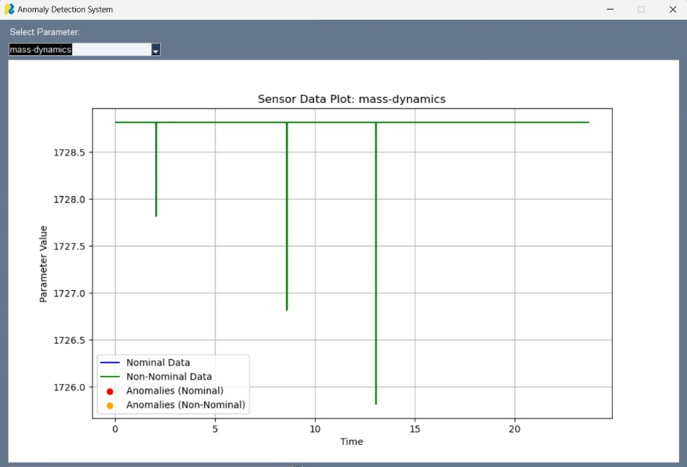

Slide 19
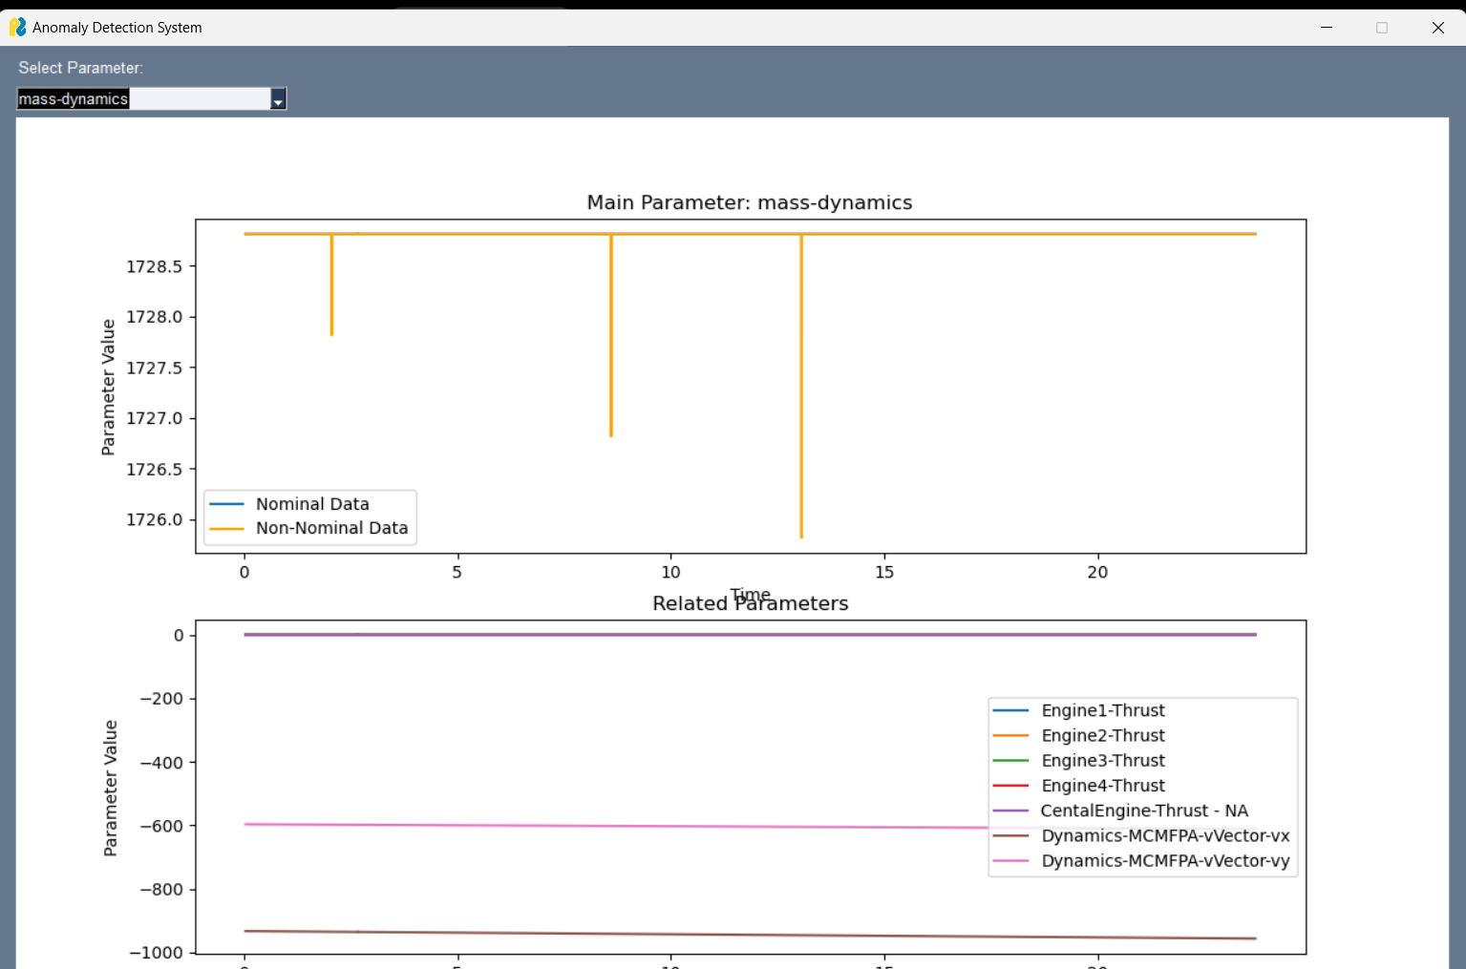

Slide 20
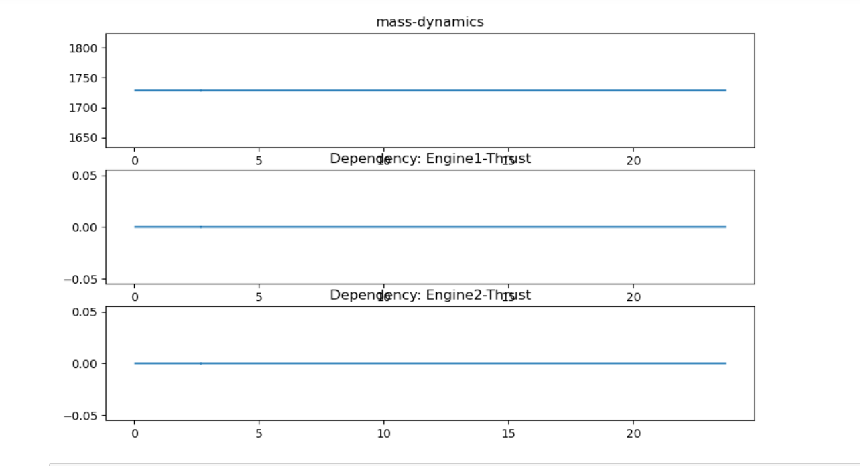

Slide 21
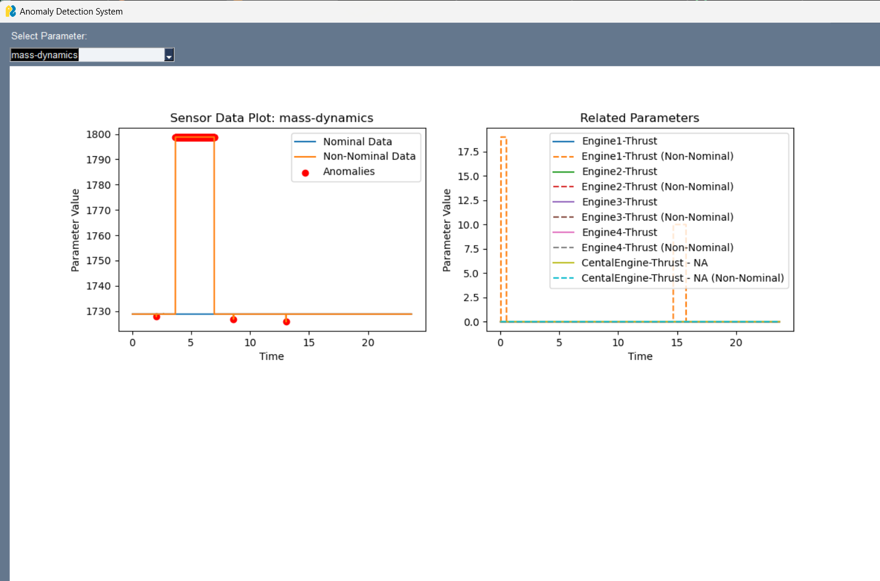

Slide 22
THANK YOU

